Slide 1




JavaScript Master Seminar
Module Pattern
Sirma Gjorgievska
Johannes Fischer
Technische Universit¨at Mu¨nchen
September 07, 2015

Slide 2
Agenda
Introduction
The Basics
Submodules
Inheritance
Shared Private State
Demonstration
Conclusion

Slide 3

Introduction
What is Module?
Integral piece of robust application's architecture
Keeps the units of code separated and organized

Slide 4
Introduction
Implementation of modules
The Module pattern
Object literal notation
AMD modules
CommonJS modules
ECMAScript Harmony modules

Slide 5
Introduction
What is Module pattern?
JavaScript design pattern
Developed in 2003
Private and public encapsulation
Mimic classes in software engineering

Slide 6

Introduction
Advantages
Cleaner approach for developers
Supports private data
Less clutter in global namespace
Localization of functions and variables

Slide 7

Introduction
Disadvantages
Inability to create automated unit tests
Lose of extendibility
Problems when changing visibility
of public/private members

Slide 8
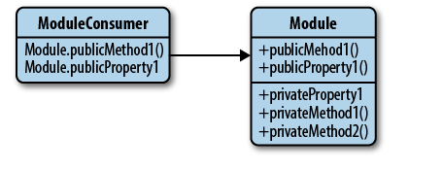
The Basics
Anonymous Closures
Private methods
Global Import
Module Export

Slide 9

The Basics
Anonymous Closures
Defined function is executed immediately
Code inside the function lives in a closure
It provides privacy and state
Maintains access to all globals
Figure: A simple anonymous closure

Slide 10
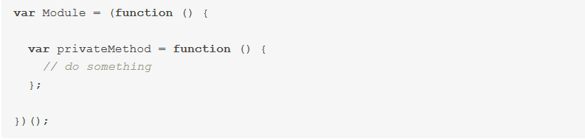
The Basics
Private methods
Methods locally declared in modules
Inaccessible outside of the scope defined
Figure: Private scope of a function

Slide 11

The Basics
Implied Globals
Hard-to-manage code
Not obvious (to humans) which variables are global

Slide 12

The Basics
Global Import
Better alternative
Passing globals as parameters to anonymous function
Clearer and faster approach
Better efficiency and readability
Figure: Importing of globals

Slide 13
The Basics
Module Export
Declare globals for further use
Return value of anonymous function
Module variables readable afterwards
Namespacing (avoids varname conflicts)

Slide 14
Submodules

Slide 15
Inheritance

Slide 16
Shared Private State

Slide 17
Live Demonstration

Slide 18

Conclusion
Conclusion
◮ We just showed the tip of the iceberg, there are much more details and many more interesting features.
◮ The AngularJS official website is a great place to start learning: https://docs.angularjs.org/
◮ Angular is a complete client-side solution which is opinionated about how a CRUD (Create, Read, Update, Delete) application should be built.
◮ Angular and its mentality is the future of the web, so if you are dealing with JavaScript in your career, sooner or later, you will end up learning such a framework.
◮ Finally we think Angular is the coolest thing happened to client side JavaScript since jQuery!

Slide 19
Thank You!

